Slide 1
Finance And Risk Analytics
Hemant Kokane
Dhanush S
Suraj Das

Slide 2


Agenda
A
Problem Statement
Business Goal
Data Preparation
Data Visualization
Portfolio Preparation
Evaluation
Conclusion

Slide 3
Problem Statement
A portfolio manager makes investment decisions and carries out other related activities on behalf of vested investors. They work with a team of analysts and researchers, and their main objective is to realize the needs of the investor and suggest a suitable portfolio that meets all the expectations. They are responsible for establishing the best investment strategy, selecting appropriate investments along with the right allocation. However, in doing so, they face a lot of competition in the form of other portfolio managers and rival firms. Therefore, the portfolio manager has to use the available resources to provide the best solution to the investor.
Consider ourselves working for an associate at an investment firm that manages accounts for private clients. Our role requires to analyze a portfolio of stocks to provide consultation on investment management based on client’s requirement.

Slide 4
Business Goal
As a portfolio manager our task is to provide consultation to two different investors, Mr Patrick Jyenger and Mr Peter Jyenger based on their requirements and financial objectives
Goal of the Case Study is :
To Suggest a Portfolio of stocks to Mr Patrick Jyenger based on his risk profile to meet his goal on doubling the amount of 500K Dollars in five years of timespan to buy a minoruty stake in Naturo.
To Suggest a High risk stocks to Mr Peter Jyenger based on his risk profile to meet his goal on gaining higher returns for the invested amount of 1 Million Dollars over a five years of timespan to use it for the expansion of JWW.

Slide 5
Data Preparation
1. Data collected from 1st October 2010 to 30th September 2020.
2. There are 24 different files we have to merge them in one file to do statistical analysis.
3. In the initial stage itself we have dropped the null values.
4. For the analysis methodology we are going to keep only necessary columns.
5. For better readability specially after merging the columns we are adding suffix to identify which column belongs to which stock.
6. Changed Datatype of Date Field to Datetime for Time-Series analysis.

Slide 6
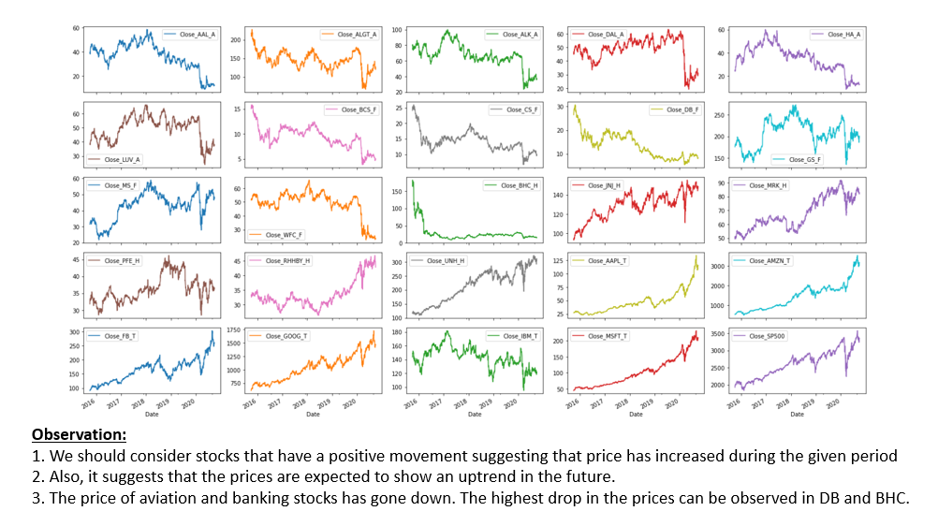
Data Visualization-Time Series Analysis

Slide 7
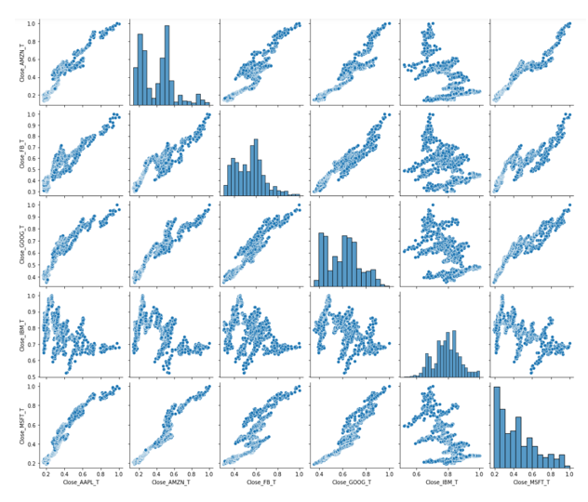
Data Visualization-Scatter Plot
Observation:
All technical stocks has positive relation except IBM

Slide 8
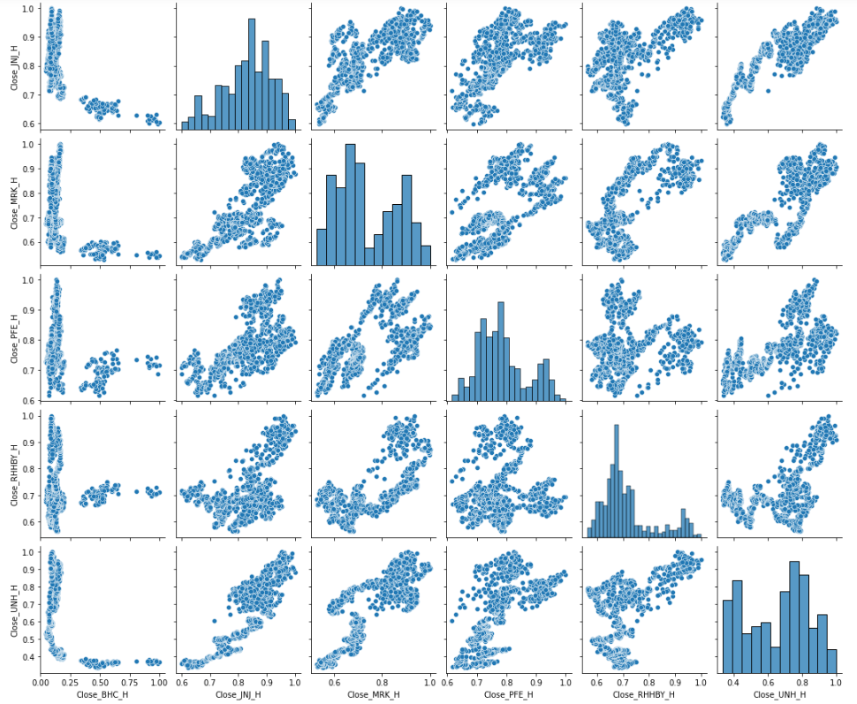
Data Visualization-Scatter Plot
Observation:
Healthcare stocks has no strong correlation compare to Technical Industry.

Slide 9
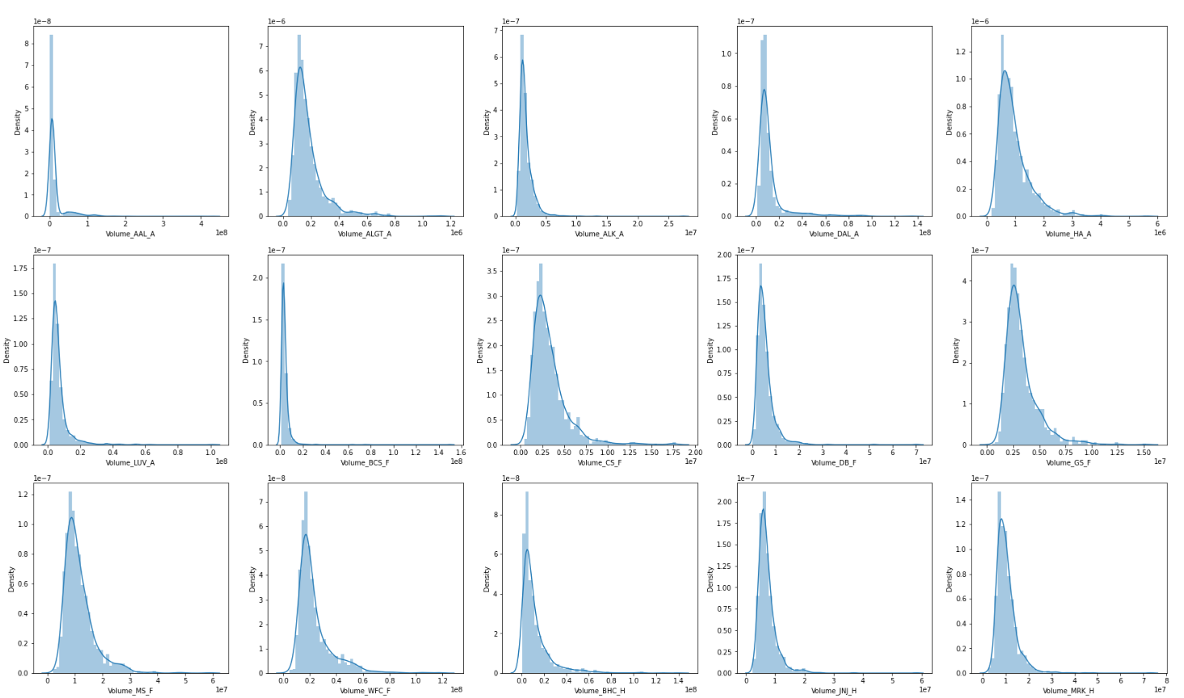
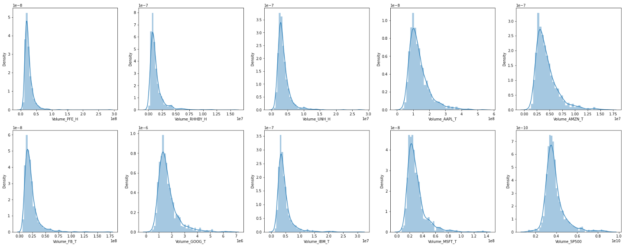
Data Visualization-Volume Histogram
Observation:
1. Higher the standard deviation, more volatile is the stock. So, in the above figures a volatile stock will cover more area.
2. ALGT, DAL, HA, CS, GS, MS, WFC, BHC, RHBY, AAPL, GOOG, IBM --> Volatility can be seen in these stocks.

Slide 10
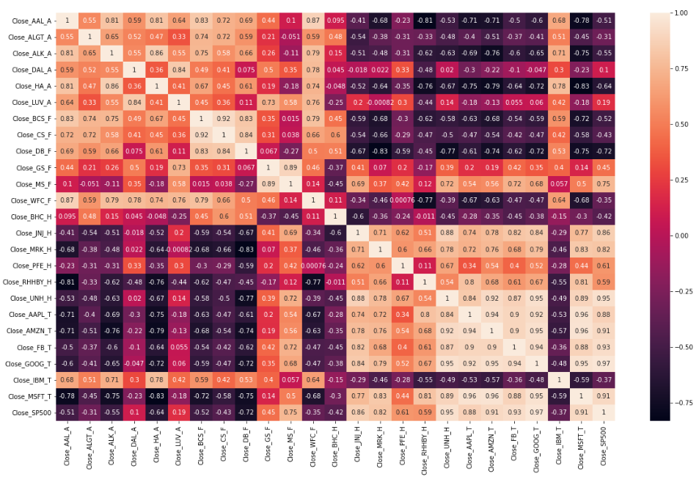
Data Visualization-Heatmap
Observations wrt S&P 500:
1. Strong Positive Correlation (0.6 to 1): Apple, Amazon, Google, Goldman Sachs, J&J, Merck & Co, Microsoft, Facebook
2. Weak Positive Correlation (0 to 0.6): American Airlines, Hawaiian Holdings, RHHBY, GS, LUV
3. Negative Correlation (0 to -1): Bausch Health, Credit Suisse, Deutsche Bank, IBM, WFC, BCS, HA
4. Ideally, the stocks that have negative correlation with the Index (S&P 500) should be avoided in the portfolio since they may prove to be very risky.

Slide 11
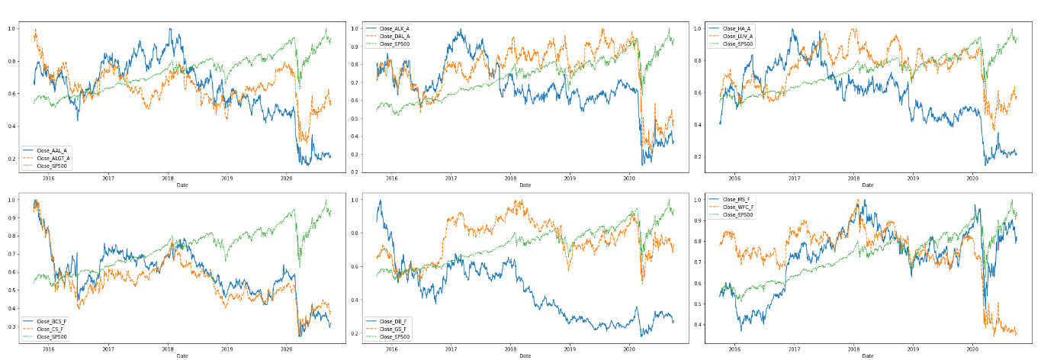
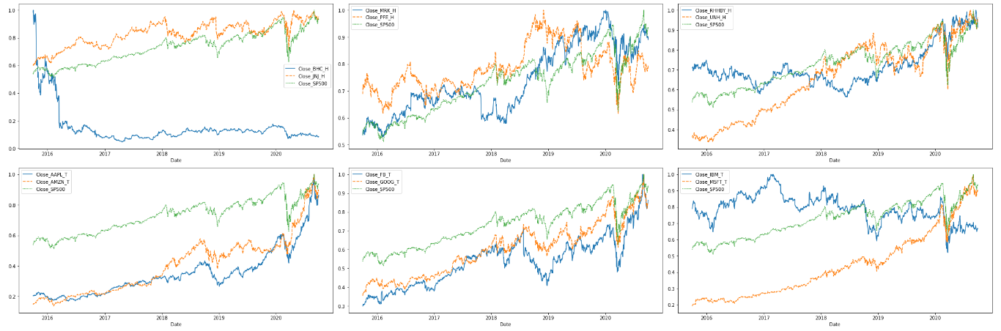
Data Visualization-Price Vs Index
Observation:
1. In Technology MSFT GOOG, FB, AAPL, AMZN are showing an uptrend, whereas IBM is showing a downtrend.
2. In Healthcare - BHC showing a downtrend
3. In Finance - DB, BCS, CS and WFC are showing a downtrend
4. In Aviation - HA, DAL, AAL, ALK are showing a downtrend.

Slide 12
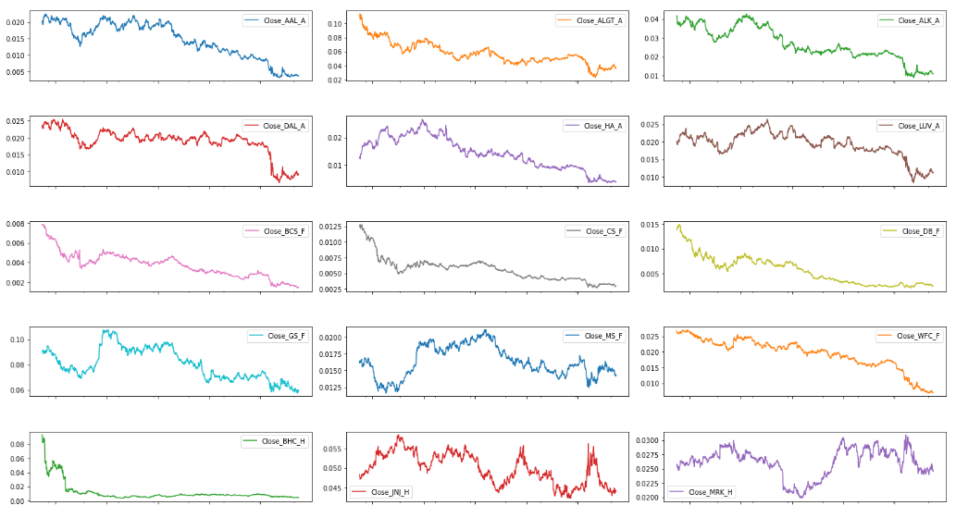
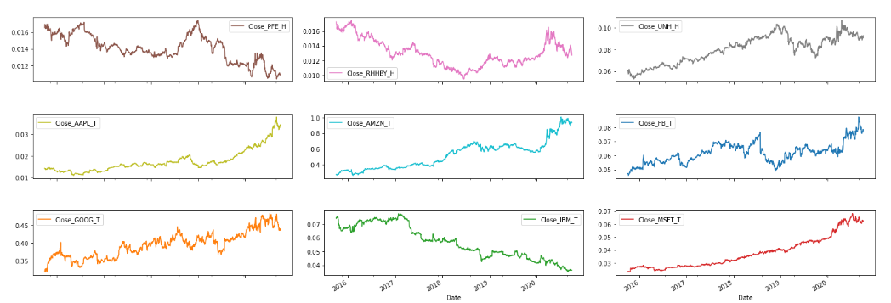
Data Visualization-Relative Strength Analysis
Observation:
1. Only few stocks have positive line wrt S&P500 Index.
2. Like MSFT, GOOG, AMZN, FB, UNH, APPL etc.
3. And other stocks are relatively weak wrt index S&P500.

Slide 13
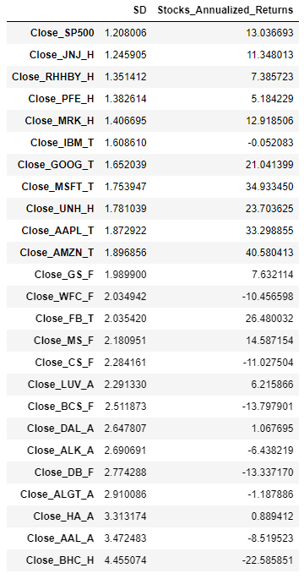
Portfolio Preparation-Standard Deviation-Return
Observation:
1. In aviation industry, the risk is high, whereas the returns are low or negative
2. In BHC, the annualized risk is highest, giving us highest negative returns - 22%.
3. Technology stocks have comparatively lower risk and higher returns
4. We should consider risk factor while making a portfolio, since though there could be an uptrend, there could be higher risk involved too.
Portfolio Selection:
On the basis of above observation and on the basis of client requirement we can create two portfolio
1. High risk with high return -for Mr Peter Jyenger
2. Low risk with high return -for Mr Patrick Jyenger

Slide 14
Portfolio Preparation-Mr. Patrick & Peter
For Mr Patrick Jyenger - Low risk with high return
1. Johnson & Johnson (JNJ)
2. Roche Holding AG (RHHBY)
3. Pfizer inc (PFE)
4. Alphabet (GOOG)
5. Microsoft (MSFT)
($500 K in five equal proportion)
For Mr Peter Jyenger - High risk with high return
1. Amazon (AMZN)
2. Microsoft (MSFT)
3. Apple Inc(AAPL)
4. Facebook (FB)
5. UnitedHealthGroup Inc (UNH)
($1 Million in five equal proportion)

Slide 15
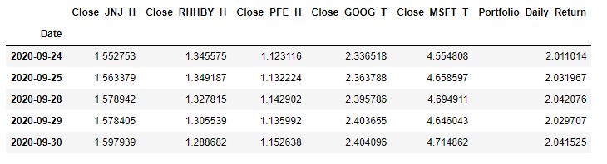
Portfolio Evaluation-Mr. Patrick
A. Cumulative return from the Portfolio
B. Portfolio Risk – Standard Deviation
0.18398308935489915
Mr.Patrick jyengar invests 500 Thousand Dollar on equities i.e the above Portfolio. Returns that he would fetch after 5 years is 1.20 Million Dollar with 520.76 Thousand dollar of gain
C. Portfolio Sharpe Ratio
0.8691748364788919
D. Total ROI from the Patrick Portfolio
520762.59790511

Slide 16
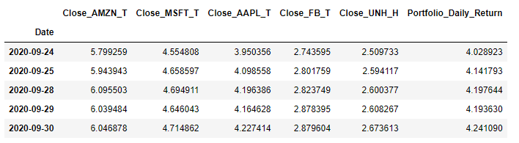
Portfolio Evaluation-Mr. Peter
A. Cumulative return from the Portfolio
B. Portfolio Risk – Standard Deviation
0.2382676144891764
Mr. Peter jyengar invests 1000 Thousand Dollar on equities that is the above Portfolio. Returns that he would fetch after 5 years is 4.24 Million Dollar with 3241.09 Thousand dollar of gain
C. Portfolio Sharpe Ratio
1.3348790598672928
D. Total ROI from the Patrick Portfolio
3241090.436563707

Slide 17
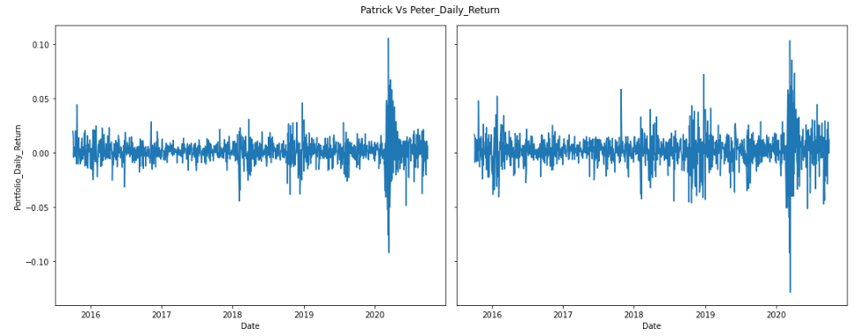
Portfolio Evaluation-Mr. Patrick Vs Mr. Peter
Patrick Vs Peter Risk(Standard Deviation Plot)
There is more deviation in Peter Portfolio compare to Patrick

Slide 18
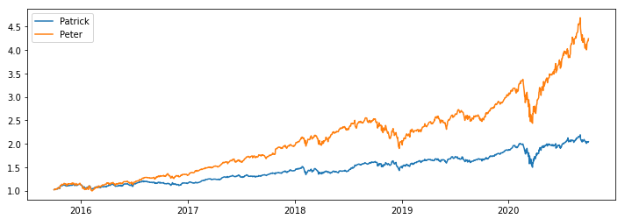
Portfolio Evaluation-Mr. Patrick Vs Mr. Peter
Patrick Vs Peter Cumulative Income
Mr. Peter’s portfolio income is much more compare to Mr. Patrick.

Slide 19
Conclusion
Mr.Patrick jyengar invests 500 Thousand Dollar on equities i.e the above Portfolio. Returns that he would fetch after 5 years is 1.20 Million Dollar with 520.76 Thousand dollar of gain
Mr. Peter jyengar invests 1000 Thousand Dollar on equities that is the above Portfolio. Returns that he would fetch after 5 years is 4.24 Million Dollar with 3241.09 Thousand dollar of gain

Slide 20
Thank you
Hemant Kokane​
Dhanush S
Suraj Das

